Slide 1
I’m taking my camera to:
Name:
Date:
Notes:
Add a picture of your country to the title page.

Slide 2
My Journey to
Insert one picture of how you travelled.
USE GOOGLE EARTH TO SEARCH THE DISTANCE AND LOCATION to travel to your country.
Describe how you travelled to ___.
Which direction did you travel?
What oceans did you see?
What continent are you going to?
Which city did you land in?
What is the weather like?

Slide 3
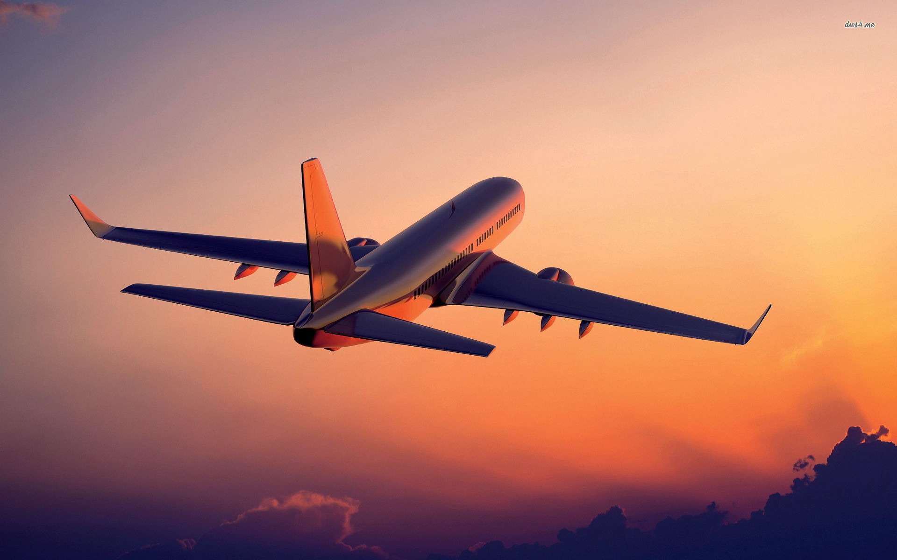
My Journey to Canada
Sample: I travelled to Canada from Ukraine by airplane. We had to travel East to get there. I looked out the window and all I could see was blue. We were flying over the Atlantic Ocean. The plane is about to land in Edmonton, Alberta, Canada. I am now on the continent of North America. Good thing I packed my winter jacket, it’s cold and snowing outside. I’ve never seen snow before!

Slide 4
Flag
Find a picture of the country’s flag that you are travelling to. What do the parts of the flag represent? Write one sentence explaining how it is similar to your flag and one sentence telling the difference. Insert a picture of the flag above.
When I landed at the airport I couldn’t help but notice Canada’s flag.
It was red and white with a maple leaf in the middle.
When I asked someone what the symbols on their flag represented they told me that...
I noticed their flag is similar to ours … A difference that I noticed was…

Slide 5
What is the capital city of the country you are studying? Write two sentences about the capital city. Find a picture of the capital city and insert it beside your answer.
Today I arrived in the capital city ______________. Write 2-3 sentences about what you see or do there. How do people travel to get around in this city or country?
Insert 1 picture.

Slide 6
What are the official languages of the country you are studying? Explain if we have any of the same official languages?
The official languages are
Where did you hear people talking?
What did you think, feel?
How do people greet each other in their language?
How do they say goodbye?

Slide 7
Food
What types of food do people eat in this country? What food is grown here? What are you going to have to eat for a meal? Where do they get their food?
Insert a few images of some of their food or meals and where they get it.
Today I had the most amazing lunch. It was…
People here get most of their food from…
Some other things that I would like to try while I am here are...

Slide 8
Describe the traditional clothing that is worn in the country you are studying. Where do they wear this clothing? what does it look like? Find a picture of a person wearing traditional clothing and place it to the right of your answer.
The traditional clothing worn here is...

Slide 9
What is a festival/celebration in the country you are studying? Describe it. What is similar about this celebration and a festival/celebration that you have? Find a picture of the festival and place it to the right of your answer.
Today I went to...

Slide 10
Interesting Facts & Places
Travel home/ Favorite part to tell classmates
Drag your pictures into the box below from the research tool or use insert to search for pictures.
Describe a souvenir that you brought home. What is it? Where did you buy it? Why did you buy it?

Slide 11
QUALITY OF LIFE
Explain in 2-3 sentences what makes their quality of life good. What changes could be made to improve their quality of life?
I think the quality of life in … is ...

Slide 12
Resources
India Images Collection
Ukranian Heritage Village Images Collection
Peru Images Collection
Tunisia Images Collection

Slide 13
Outcomes | Concerns | Criteria | Advanced
3.1.1 - appreciate similarities and differences among people and communities: demonstrate an awareness of and interest in the beliefs, traditions and customs of groups and communities other than their own. 3.1.2 - examine the social, cultural and linguistic characteristics that affect quality of life in communities in other parts of the world by exploring and reflecting upon the following questions for inquiry: | Where can I improve? | I demonstrate a practical understanding of differences among people and communities My narrative very accurately explains with details: Arriving Flag Capital City Languages Food Traditional Clothing Festivals/Celebrations Souvenir Quality of Life My images enhance my explanation Group Work: Positive talk Doing my share | Where did I excel?
Notes:
http://www.learnalberta.ca/ProgramOfStudy.aspx?lang=en&ProgramId=564423#640576

